Slide 1

Data-Driven Cricket Performance Analysis.
CHINTHA KALYAN
Batch No :450
Innomatics Research
Labs ,Dilshuknagar

Slide 2
About me
I am CHINTHA KALYAN.
I completed my Graduation in Computer Science and (internet of Things) from Balaji Group of Institution Warangal.
LinkedIn :https:/linkedin.com/in/kalyan-chintha-481133323/
GitHub : https://github.com/7386472091

Slide 3
Agenda:
Business Problem
Problem Statement
Objectives
Scraping
Data Cleaning
Dataset Overview
Univariant Analysis
Bivariant Analysis
Multivariant Analysis
Hypothesis testing
visualization
Application & Recommendations
Conclusion.

Slide 4
Business Problem:
Cricket selectors lack a data-driven method to identify consistent and high-impact batting performers.
It is difficult to distinguish between players who score occasional big innings and those who contribute consistently across matches.
Teams face challenges in optimizing squad selection using performance metrics like runs, averages, and centuries.
Coaches need better insights to convert half-centuries into match-winning centuries.
There is a need to use historical performance data to improve decision-making and team success.

Slide 5
Problem Statements:
Cricket teams often rely on subjective judgment rather than data-driven analysis for player evaluation.
It is challenging to accurately measure player consistency and performance impact using raw statistics alone.
Identifying players who can consistently contribute runs across matches remains a key problem.
Coaches lack analytical insights to understand the gap between half-centuries and centuries.
Inefficient use of performance data can lead to suboptimal team selection decisions.
A structured analysis of batting metrics is required to improve performance and team outcomes

Slide 6
Objectives:
To analyze player performance using key batting metrics such as runs, matches, averages, 50s, and 100s.
To identify consistent and high-performing players through statistical analysis.
To understand the distribution of half-centuries and centuries among players.
To uncover patterns and relationships that influence batting performance.
To support data-driven decision making for team selection and performance improvement.

Slide 7
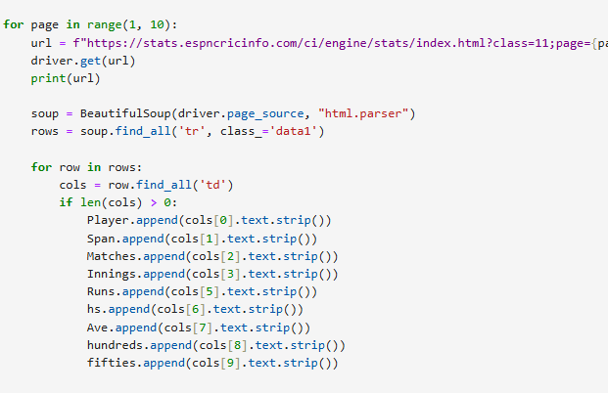
Scraping:
Sending a Request: The scraper sends a request to a website’s server to access a webpage.
Retrieving HTML Content: The website responds with the HTML, CSS, and JavaScript code of the page.
Parsing Data: Tools like Beautiful Soup, Selenium, or Scrapy extract the desired information from the HTML.
Cleaning & Structuring: Extracted data is cleaned and organized into tables, CSVs, or databases.
Analysis & Visualization: The structured data can then be analyzed or visualized for insights.

Slide 8
Dataset Overview:
The dataset contains batting performance statistics of cricket players across multiple matches.
Key variables include total runs scored, matches played, batting average, number of centuries, and half-centuries.
Each record represents an individual player’s overall career or tournament performance.
The data captures both consistency metrics (average and 50s) and high-impact metrics (100s).
The dataset includes players with varying levels of experience and performance.
It is suitable for univariate, bivariate, and multivariate statistical analysis.
The dataset supports performance evaluation, comparison, and strategic decision-making in cricket analytics.

Slide 9
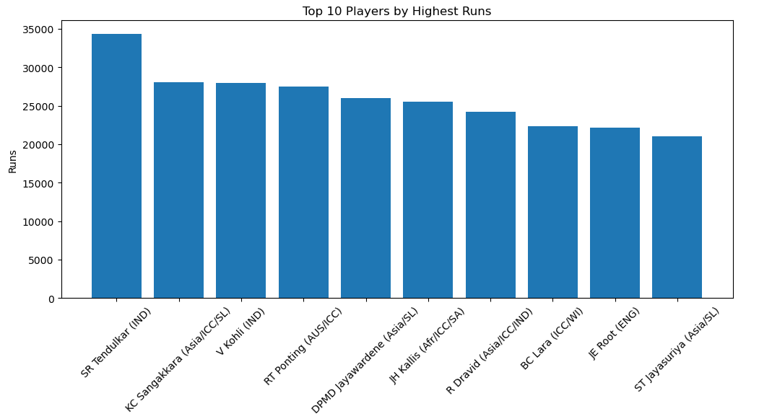
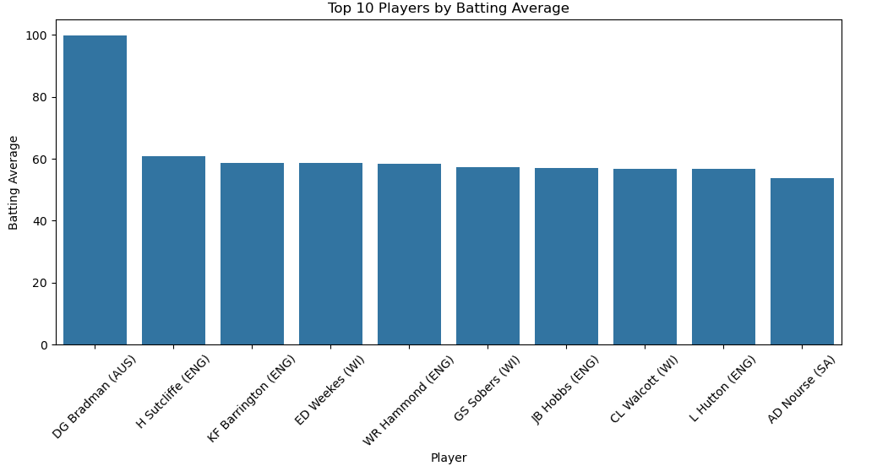
Univariant Analysis:
The chart represents total runs scored by the top 10 cricket players.
Each bar corresponds to a player, showing their cumulative runs.
SR Tendulkar (IND) leads with the highest runs 34,000.
Other top performers include KC Sangakkara (Asia/CC/SL), V Kohli (IND), and RT Ponting (AUS/ICC), all scoring between 27,000–28,000 runs.
The lowest among the top 10 is ST Jayasuriya (Asia/SL) with 21,000 runs.
Don Bradman stands far above all others with an exceptional batting average of nearly 100, making him a clear outlier.
The remaining players cluster between 53–61, showing relatively similar consistency among top batters.
Herbert Sutcliffe ranks second, but there is a large gap between him and Bradman.
Most players in the top 10 belong to England and West Indies, highlighting their strong historical batting depth.
Overall, the chart shows that while many players are highly consistent, Bradman’s dominance is unmatched in cricket history

Slide 10
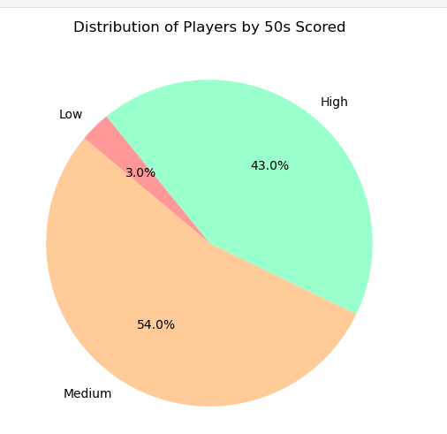
54% of players fall in the Medium category, showing that most players consistently score half-centuries.
43% of players are High 50s scorers, indicating strong and reliable batting performance.
Only 3% of players are in the Low category, meaning very few players struggle to score 50s.
The distribution is heavily skewed toward consistent performers, with 97% in Medium and High groups.
Overall, the dataset mainly represents experienced and dependable batsmen rather than weak performers.

Slide 11
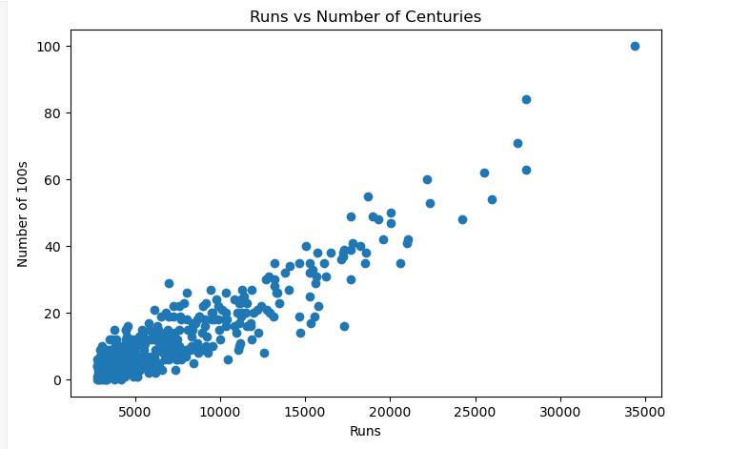
Bivariant Analysis:
Insights:
Positive Relationship: The number of centuries increases as total runs increase, indicating consistent high-scoring players achieve both volume and milestones.
Outliers: A few players with very high runs and centuries stand out as elite performers.
Performance Patterns: Players with moderate runs still score centuries occasionally, but high total runs almost always correspond with multiple centuries.
Consistency Indicator: This chart highlights not just total performance but the ability to convert innings into big scores (centuries).

Slide 12
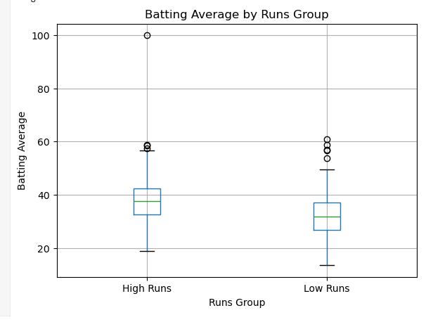
Insights
Players in the High Runs group generally have a higher median batting average than those in the Low Runs group.
The spread (IQR) of averages is wider for High Runs players, showing more variability in performance.
Several outliers appear in both groups, indicating exceptional individual performances.
The Low Runs group has a lower central tendency, suggesting fewer consistent high scorers.
Overall, the plot shows that higher run accumulation is usually associated with better batting averages, though exceptions exist.

Slide 13
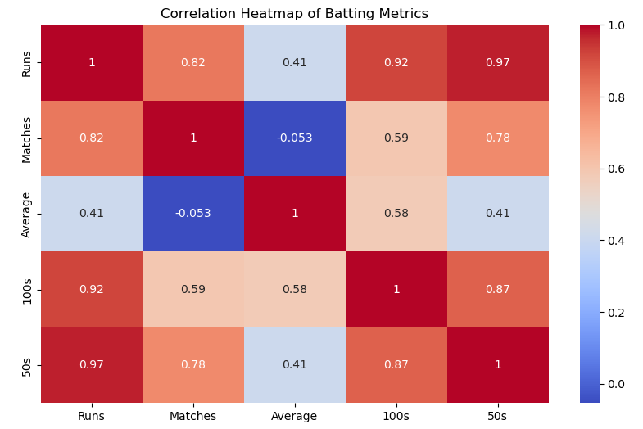
Multivariant Analysis:
Runs as central metric: Runs have very strong positive correlations with both, total runs are a good indicator of scoring performance.
Matches vs Performance: Number of matches is correlated with runs and 50s/100s, but not with consistency (Average) is independent of experience (Matches).
Average is independent: Batting average has weaker correlations with other metrics, meaning high average doesn’t always mean high runs or many 50s/100s.
50s and 100s trend: High correlation (0.87) between 50s and 100s suggests players scoring fifties often convert some into centuries.

Slide 14
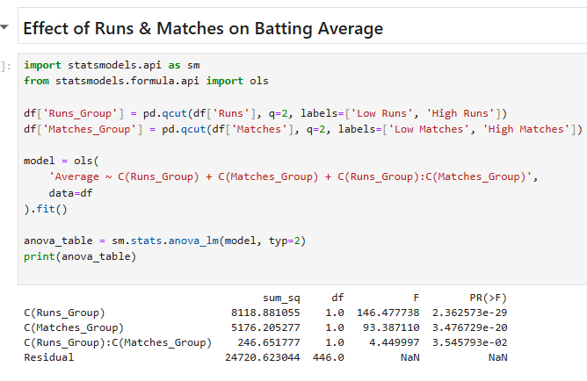
Hypothesis Testing:
Runs scored: Look at the distribution to see top scorers and average consistency.
Players with very high runs tend to have played more matches (positive correlation between Runs and Matches).
Average: Indicates consistency; high average + high runs = reliable player.
Centuries and Half-Centuries (100s and 50s):
Players with more 100s tend to have higher averages.
50s are more common; scoring 50s often shows consistency even if 100s are fewer.

Slide 15
Application & Recommendations
The dataset can be used to evaluate player performance based on runs, averages, and scoring consistency.
It helps in team selection and squad planning by identifying reliable and high-impact players.
Coaches can apply this analysis to design focused training programs for different player categories.
Since most players score many 50s, emphasis should be on converting half-centuries into centuries.
Consistent performers with high averages should be retained as core team members.
Players with low 50s and averages should receive technical and mental skill improvement support.
Overall, the dataset enables data-driven decisions to improve team balance and match outcomes.

Slide 16
Conclusion:
Most players show strong consistency, with a high proportion scoring medium to high numbers of 50s.
A positive relationship is observed between centuries, half-centuries, and batting average.
Only a small percentage of players fall into low-performance categories, indicating a strong overall dataset.
The dataset provides a comprehensive view of player performance using runs, matches, averages, centuries, and half-centuries.
The analysis highlights the importance of consistency alongside match-winning performances.
Overall, the dataset is effective for performance evaluation, selection strategy, and data-driven decision making in cricket.

Slide 17


Slide 18

THANK YOU

